Slide 1
Data-driven Visualizations

Slide 2
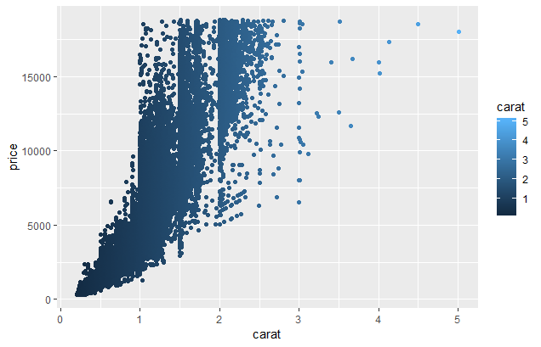
What is effective about this? What is not?

Slide 3
What is effective about this? What is not?
Effective
No optical illusions
Not effective
Extraneous grid lines
Unnecessary color
Low contrast between shades of blue
Font sizes (presentations vs manuscripts)

Slide 4
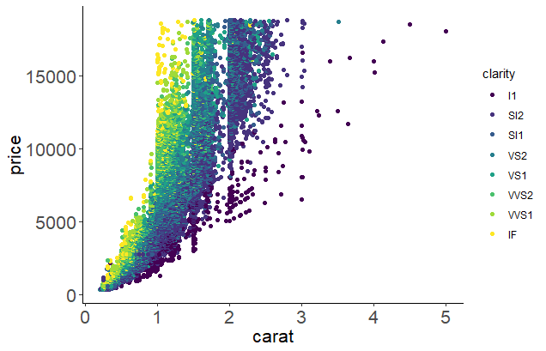
What improvements can we make?
Increased data density with colors
No optical illusions
Color contrasts
Removed grid lines
Increased font size for readability

Slide 5
What else could we improve?
Test or change color to grayscale
Increase legend size
What is clarity? Is it ordered?
For a presentation, rotate y-axis label to horizontal
Add commas (or periods in Europe) to large numbers if domain- or journal-specific allows

Slide 6
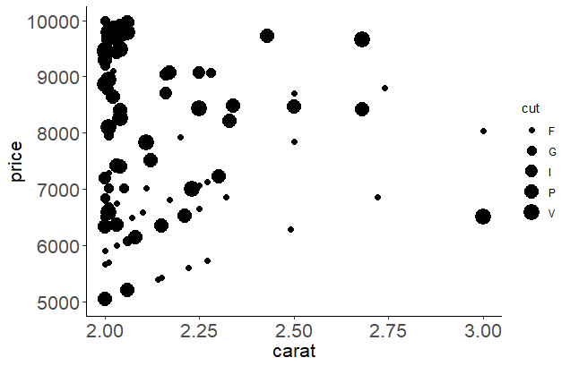
What is clear or misleading about this?

Slide 7
What is clear or misleading about this?
Clear
Chart design consistent throughout
Units appropriate
Potentially misleading
Symbols and axes proportional to numbers represented (problem with pie charts, area in general)
Lack of context: did not show all relevant data
Clear labels (minimize abbreviations)

Slide 8
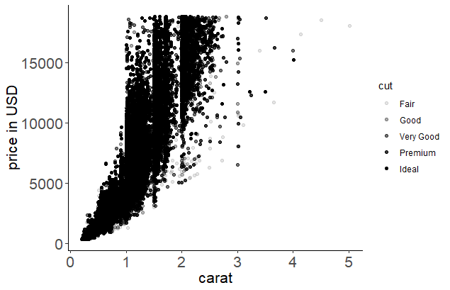
What improvements can we make?
Removed area-cut relationship
Show full range of data
Units for y-axis
Labels not abbreviated

Slide 9
What else could we improve?
Decide if data density in interior is acceptable
Make “fair” easier to see from a distance (darker color)
Make all points easier to see from a distance (larger size)
Consider goal – do we need all cut categories?

Slide 10
Please take 3 min to help us improve
Survey link:
Today’s topic: Data-driven visualizations
Notes:
For those who didn’t bring a device, offer to email them via EventBrite

Slide 11
Find more resources and upcoming events!
Impact Challenge https://libraries.ou.edu/ impactchallenge
Feb 4-8: Make your data discoverable
Feb. 11-15: Share software with Github
Feb. 18-22: Understand DOIs
Carpentries two-day workshops https://libraries.ou.edu/ carpentries
Digital Skills Hub Calendar https://digitalskills.oucreate.com
Information Specialists @ DAVIS https://libraries.ou.edu/davis
Digital Scholarship Lab https://libraries.ou.edu/dsl

